Slide 1

32555 – Fundamentals of Software Development

Slide 2
Welcome to 32555 – Fundamentals of Software Development
Your Teaching Team:
Dr. Yining Hu | Subject Coordinator
Yining is a Lecturer in Software Engineering. She works with many SMEs to develop software and AI solutions through student and research projects at UTS.
Contact: yining.hu@uts.edu.au
Dr. Xiaojie (Zoe) Lin | Tutor
Zoe is a full-stack software engineer with an interest in data analysis, specializing in JAVA, R, Python, JavaScript, PHP, Bash, and MATLAB; familiar with AWS.
Contact: Xiaojie.Lin@uts.edu.au
Dr. Farshid Keivanian | Tutor
Dr. Farshid Keivanian is an experienced university lecturer and researcher with a PhD in Information Technology. He has over 15 years of teaching experience across Australian institutions, specialising in software engineering, data science, AI, and cybersecurity.
Contact: Farshid.Keivanian@uts.edu.au
Yong Pov | Tutor
Yong is a full-stack software engineer with experience in React, JavaScript, TypeScript, Java, Python, SQL, and AI-assisted learning platforms.
Contact: Yong.Pov@uts.edu.au

Slide 3
Welcome to 32555 – Fundamentals of Software Development
Cmp1 # | Location | Time | Tutor
01 | CB11.B1.400 | Fri 16:00-18:00 | Xiaojie (Zoe) Lin
07 | CB11.B1.401 | Wed 10:00-12:00 | Farshid Keivanian
08 | CB11.B1.400 | Fri 12:00-14:00 | Yong Pov
09 | CB11.B1.103 | Wed 16:00-18:00 | Farshid Keivanian
10 | CB11.B1.401 | Wed 12:00-14:00 | Farshid Keivanian

Slide 4
Week 4 Outline
Have you formed your group?
Assessment Task 1: Case Study – Part 1: Analysis and Design Preparation Guide
Lab 4 Exercises
What Are Control Statements?
Conditional Statements
If-Else Example: Voting Eligibility in Python
Activity 1: Try Different Ages
If-Else Example: Voting Eligibility in Java
Activity 2: Add a Second Condition
Looping Statements
Jump Statements
Bank Case Study (Link to Lab 4)
Activity 3: Try Different Transactions
Activity 4: Simulate a Blocked Account
Learning Reinforcement (2 min)
Activities 5 and 6
Problem-Solving Example (Factorial – Lab 4 Ex.8) – Python
Problem-Solving Example (Factorial – Lab 4 Ex.8) – Java
Activity 7
Role-Playing Debate Questions (2 min)

Slide 5
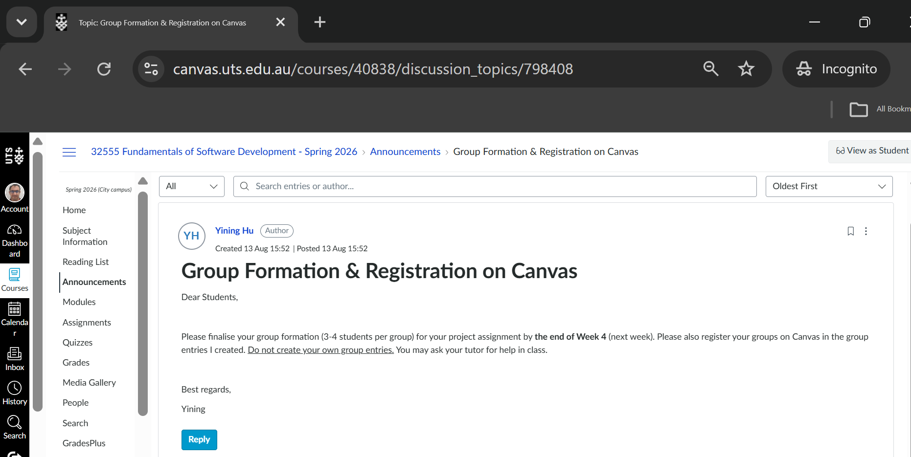
Have you formed your group?

Slide 6
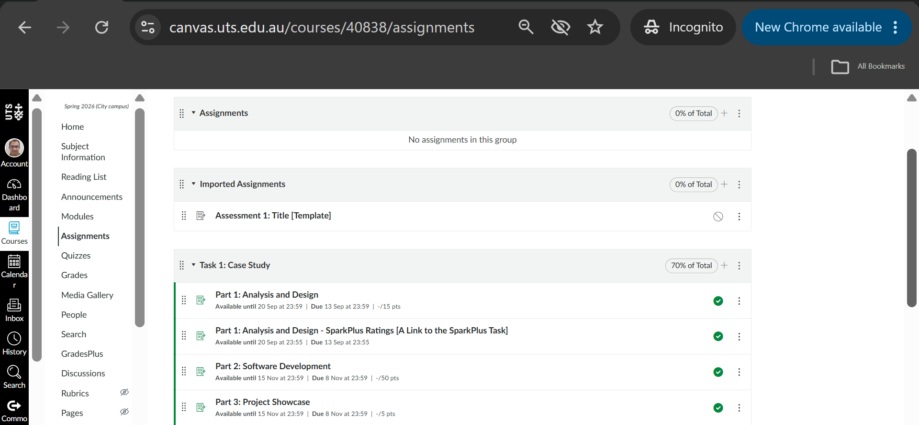
Have you formed your group?

Slide 7
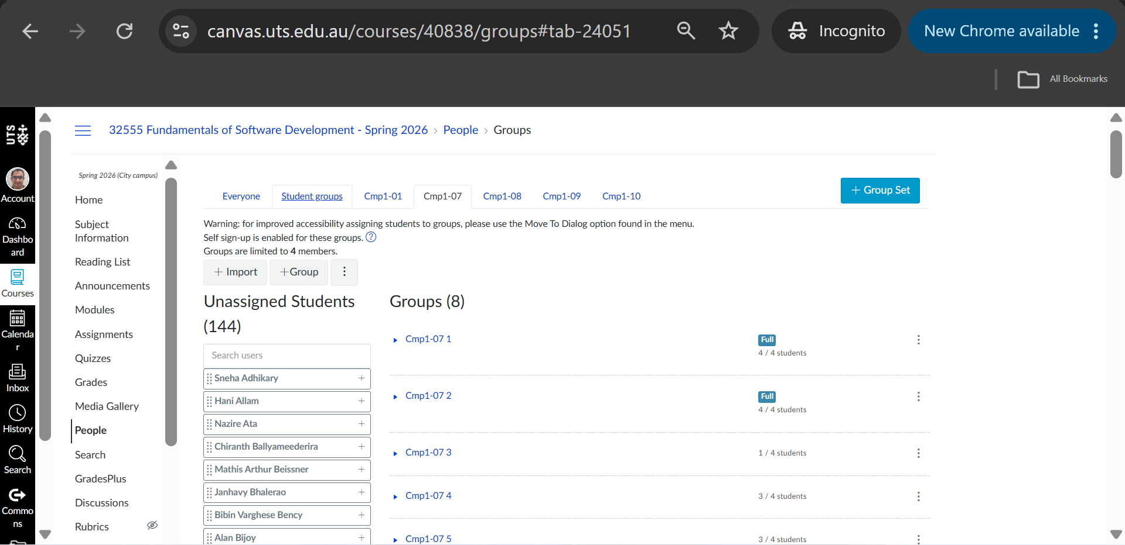
Have you formed your group?

Slide 8
Have you formed your group?
Dear Dr. Keivanian,
I hope you are doing well.
I am writing to follow up and ask whether there are any students in the other sections who are currently without a group for the Java project.
I am Hani Allam from Section 09, on Wednesdays from 16:00–18:00. I have good experience with Java and JavaFX, as Java was the main programming language used during my bachelor's degree.
I would appreciate it if you could let me know if there are any students currently looking for a group to work on the project in Java.
If there are any students interested, they can contact me at hani.allam@student.uts.edu.au to discuss forming a group.
Kind regards, Hani Allam

Slide 9
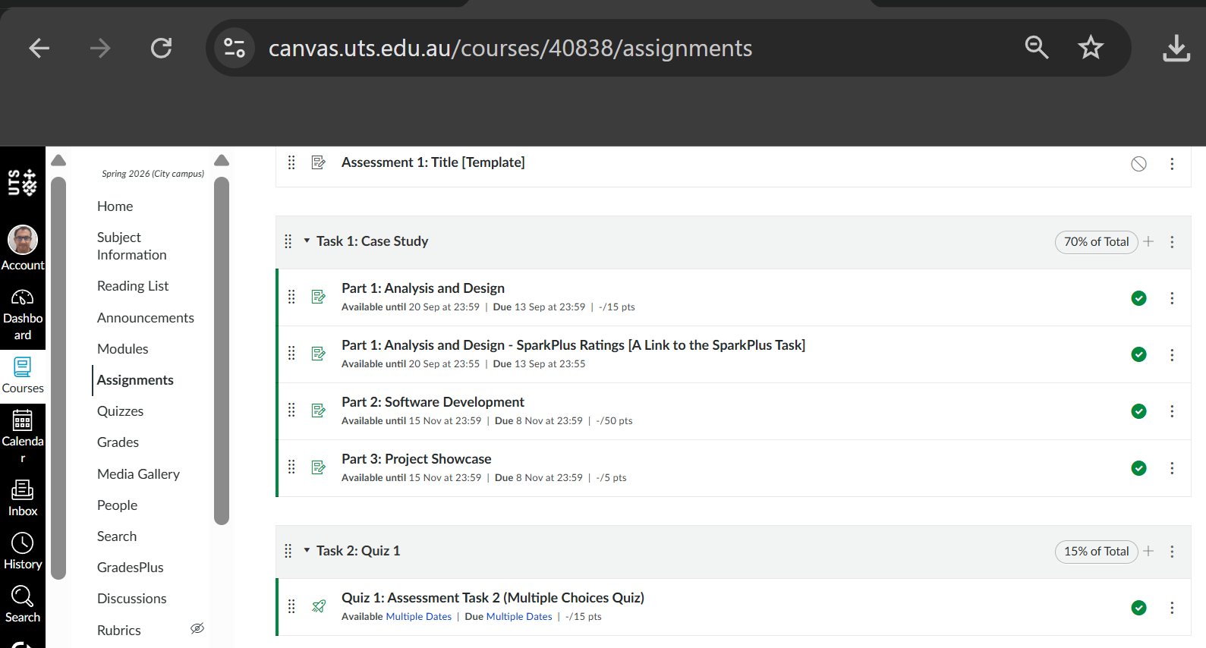
Assessment Task 1: Case Study – Part 1: Analysis and Design Preparation Guide

Slide 10
Assessment Task 1: Case Study – Part 1: Analysis and Design Preparation Guide
For this assessment, your diagram should be based directly on the project requirements. Do not add functions that are not required by the case study.

Slide 11
Assessment Task 1: Case Study – Part 1: Analysis and Design Preparation Guide
Before You Start: What Are You Trying to Show?
A use case diagram answers three simple questions:
Who uses the system?
These are called actors.
What can they do?
These are called use cases.
How are they connected?
These are shown using relationships.

Slide 12
Assessment Task 1: Case Study – Part 1: Analysis and Design Preparation Guide
For this project, the main actors are:
Student – a person who registers and uses the student enrolment functions.
Admin – an existing university staff member who manages registered students.
The system itself can be represented by a large rectangle called:
University Self-Enrolment System
The Student and Admin actors stay outside this rectangle, while the use cases stay inside it.

Slide 13
Assessment Task 1: Case Study – Part 1: Analysis and Design Preparation Guide
For the UML Use Case Diagram in this project, the external actors are Student and Admin. The system itself is not an actor in its own use case diagram. It is represented by the system boundary, and the use cases are placed inside that boundary.

Slide 14
Assessment Task 1: Case Study – Part 1: Analysis and Design Preparation Guide
Important: This is different from the User-Story Backlog. In the backlog, the User column can represent a person or entity taking the action, so System may appear there for an automatic system action. Do not confuse a backlog “User” with a UML “Actor”.

Slide 15
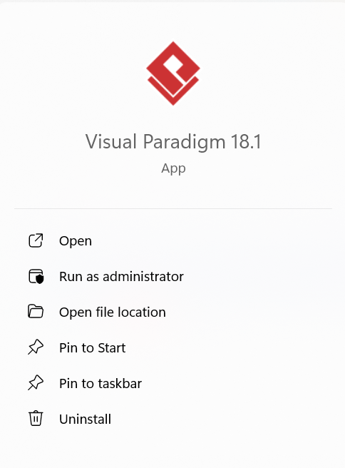
Assessment Task 1: Case Study – Part 1: Analysis and Design Preparation Guide
1. Open the Use Case Diagram
In Visual Paradigm, create a new project or open your Assessment 1 project.
Select:
Diagram → New → UML → Use Case Diagram
If you already see a blank page similar to the screenshot provided, you are ready to continue.

Slide 16
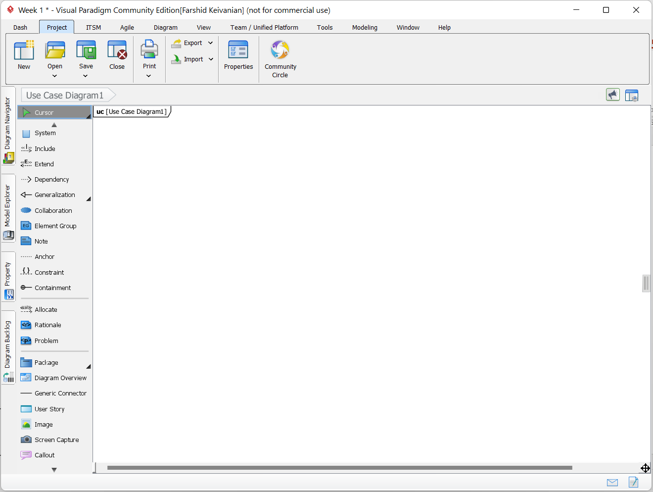
Assessment Task 1: Case Study – Part 1: Analysis and Design Preparation Guide
Why do we do this?
A Use Case Diagram is the correct UML diagram for representing interactions between users and system functionality.
Skill developed
You learn how to select the correct UML modelling technique for a software requirement.

Slide 17
Assessment Task 1: Case Study – Part 1: Analysis and Design Preparation Guide
2 – Create the System Boundary
From the toolbox on the left side of Visual Paradigm, select System.
Click and drag on the blank diagram area to create a large rectangle.
Rename it: University Self-Enrolment System

Slide 18
Assessment Task 1: Case Study – Part 1: Analysis and Design Preparation Guide
Q: What defines the scope of our system?
A: The system boundary. Now do: Select System from the left toolbar, draw the rectangle, and name it University Self-Enrolment System.

Slide 19
Assessment Task 1: Case Study – Part 1: Analysis and Design Preparation Guide
Make the rectangle large enough to place all the required use cases inside it.
Why do we do this?
The system boundary tells the reader which functions belong to the application.
Anything inside the rectangle is functionality provided by the university application.
The actors remain outside the rectangle.

Slide 20
Assessment Task 1: Case Study – Part 1: Analysis and Design Preparation Guide
Skill developed
You learn how to define the scope of a software system and distinguish between the system and its users.

Slide 21
Assessment Task 1: Case Study – Part 1: Analysis and Design Preparation Guide
3 – Add the Student Actor
Locate the Actor tool in the Visual Paradigm toolbox. Select Actor, then click on the left side outside the system rectangle.
Rename the actor: Student

Slide 22
Assessment Task 1: Case Study – Part 1: Analysis and Design Preparation Guide
Why do we do this?
The Student is one of the main users interacting with the system.
The Student should be shown as an actor rather than as part of the system because the Student is an external user.

Slide 23
Assessment Task 1: Case Study – Part 1: Analysis and Design Preparation Guide
Skill developed
You learn how to identify actors from written software requirements.
A useful question is:
“Who is asking the system to perform something?”
For example, when the requirement says that students can enrol in subjects, the Student is the actor.

Slide 24
Assessment Task 1: Case Study – Part 1: Analysis and Design Preparation Guide
4 – Add the Admin Actor
Create another actor outside the system boundary, preferably on the right side.
Rename it: Admin
Remember that the case study states that Admins are existing university staff and do not need to register.

Slide 25
Assessment Task 1: Case Study – Part 1: Analysis and Design Preparation Guide
Why do we do this?
Student and Admin have different responsibilities.
Keeping them as separate actors makes the system requirements easier to understand.
Skill developed
You practise separating different user roles and responsibilities.

Slide 26
Assessment Task 1: Case Study – Part 1: Analysis and Design Preparation Guide
5 – Create the Student Registration Use Cases
Inside the system boundary, create use cases for the registration process.
A use case is normally shown as an oval.
Read the Requirements and create them
You can position these near the upper-left area of the system.

Slide 27
Assessment Task 1: Case Study – Part 1: Analysis and Design Preparation Guide
Why do we do this?
The project requires students to register before accessing the system.
Registration involves several important behaviours:
entering registration information;
checking the email;
checking the password;
generating the six-digit student ID.

Slide 28
Assessment Task 1: Case Study – Part 1: Analysis and Design Preparation Guide
Breaking the requirement into meaningful use cases makes the design clearer.
Skill developed
You learn how to decompose a large requirement into smaller system functions.

Slide 29
Assessment Task 1: Case Study – Part 1: Analysis and Design Preparation Guide
5 – Create the Student Registration Use Cases
Inside the system boundary, create use cases for the registration process.
A use case is normally shown as an oval.
Read the Requirements and create them
You can position these near the upper-left area of the system.

Slide 30
Assessment Task 1: Case Study – Part 1: Analysis and Design Preparation Guide
6. Create the Student Login Use Cases
Why do we do this?
Only registered students should be able to access the Student subsystem.
Login therefore represents an important interaction between the Student and the application.
Skill developed
You learn how authentication requirements are represented in system modelling.

Slide 31
Assessment Task 1: Case Study – Part 1: Analysis and Design Preparation Guide
7 – Add the Main Student Functions
Create required use cases inside the system:
Connect the Student actor to each of those use cases you add.
These are directly stated in the project brief.

Slide 32
Assessment Task 1: Case Study – Part 1: Analysis and Design Preparation Guide
Why do we do this?
Use case diagrams should be based on actual requirements, not assumptions.
These four actions are specifically listed as operations available to registered students.
Skill developed
You practise converting written customer requirements into UML use cases.

Slide 33
Assessment Task 1: Case Study – Part 1: Analysis and Design Preparation Guide
8 – Add the Supporting Enrolment Functions
The enrolment process has several automatic system behaviours.
Identify the automatic behaviours required to complete enrolment. Decide whether they need to appear as supporting use cases or whether they are better explained as rules/steps within the main use case. Do not turn every programming operation into a separate use case. These support the main Enrol in Subject use case.
The system must make sure that the Student has no more than four subjects.
When enrolment is successful, the system automatically do required actions.

Slide 34
Assessment Task 1: Case Study – Part 1: Analysis and Design Preparation Guide
Why do we do this?
These functions happen as part of enrolment even though the Student does not manually request each one.
Skill developed
You learn the difference between a user goal and an internal function required to complete that goal.

Slide 35
Assessment Task 1: Case Study – Part 1: Analysis and Design Preparation Guide
9 – Add the Admin Use Cases
Create the required use cases on the Admin side of the system:
Connect the Admin actor to each of them.
Why do we do this?
They will be the student-management functions explicitly assigned to Admins in the project brief.
The Admin does not use the Student registration process.

Slide 36
Assessment Task 1: Case Study – Part 1: Analysis and Design Preparation Guide
Skill developed
You practise mapping permissions and functionality to the correct user role.

Slide 37
Assessment Task 1: Case Study – Part 1: Analysis and Design Preparation Guide
10 – Add Relationships Between Actors and Use Cases
You may think if it is correct to use a normal Association line for connecting an actor to a use case that the actor directly performs.
If correct, an association is normally drawn as a solid line without an arrow.

Slide 38
Assessment Task 1: Case Study – Part 1: Analysis and Design Preparation Guide
Why do we do this?
The association tells the reader which actor initiates or participates in a use case.
Skill developed
You learn how to communicate user-system interactions using standard UML notation.

Slide 39
Assessment Task 1: Case Study – Part 1: Analysis and Design Preparation Guide
11 – Use <<include>> Where the Function Must Always Occur
Use <<include>> when one use case must perform another use case every time.
When drawing <<include>>, the dashed arrow should point towards the included use case.
For example: Register → Validate Email

Slide 40
Assessment Task 1: Case Study – Part 1: Analysis and Design Preparation Guide
Why do we do this?
Email validation is not optional during registration. Therefore, it is something the Register use case must include.
Skill developed
You learn to recognise mandatory reusable system behaviour.

Slide 41
Assessment Task 1: Case Study – Part 1: Analysis and Design Preparation Guide
12 – Be Careful with <<extend>>
Use <<extend>> only where extra behaviour happens under a particular condition.
For this project, do not add <<extend>> simply because the tool is available.
For example, attempting to enrol in a fifth subject causes the system to notify the Student. This can be represented as conditional behaviour associated with checking the enrolment limit.

Slide 42
Assessment Task 1: Case Study – Part 1: Analysis and Design Preparation Guide
If you model it separately, you could create:
Display Maximum Enrolment Error
and use an extension associated with the enrolment process.
However, it is also acceptable to explain the error as part of the Check Enrolment Limit use case rather than overcrowding the diagram.

Slide 43
Assessment Task 1: Case Study – Part 1: Analysis and Design Preparation Guide
Read: “A student can enrol in a maximum of four subjects.” Think: What system behaviour does this requirement imply?
Answer: The system needs to check the enrolment limit. Model: Add Check Enrolment Limit. It supports Enrol in Subject because the system must check the limit before accepting another subject.

Slide 44
Assessment Task 1: Case Study – Part 1: Analysis and Design Preparation Guide
Why do we do this?
A common mistake is using <<include>> and <<extend>> without understanding them.
Remember:
<<include>> = always required
<<extend>> = happens only under a condition
Skill developed
You develop stronger understanding of UML relationship semantics rather than simply drawing lines.

Slide 45
Assessment Task 1: Case Study – Part 1: Analysis and Design Preparation Guide
Question: During registration, can the system skip email validation?
Answer: No.
Question: Can it skip password validation?
Answer: No.
Question: So are these mandatory parts of registration?
Answer: Yes.

Slide 46
Assessment Task 1: Case Study – Part 1: Analysis and Design Preparation Guide
Conclusion: We use <<include>> because these actions must happen every time registration occurs.
Question: Does the system display a maximum-enrolment error every time a Student enrols?
Answer: No. It happens only when the Student tries to exceed four subjects.

Slide 47
Assessment Task 1: Case Study – Part 1: Analysis and Design Preparation Guide
Conclusion: This is conditional behaviour, so it may be represented using <<extend>>, or explained as an alternative flow without adding another oval if you want to keep the diagram simple.

Slide 48
Assessment Task 1: Case Study – Part 1: Analysis and Design Preparation Guide
13 – Do Not Put students.data as an Actor
The application stores student and enrolment information in: students.data
However, for this assessment, it normally does not need to be shown as a human actor.
You can explain in the accompanying text that CLIUniApp operations read and write student information using students.data.

Slide 49
Assessment Task 1: Case Study – Part 1: Analysis and Design Preparation Guide
Why do we do this?
A use case diagram should focus mainly on external users and their goals.
Technical implementation details are better represented later in the class diagram and implementation.
Skill developed
You learn to distinguish between functional requirements and implementation details.

Slide 50
Assessment Task 1: Case Study – Part 1: Analysis and Design Preparation Guide
14 – Keep CLIUniApp and GUIUniApp in Perspective
Part 1 describes the complete university application, while GUIUniApp is identified as a smaller challenge component for Part 2.
Your main Use Case Diagram should therefore focus on the required system behaviour.
The Student and Admin functionality described in the project requirements should be clearly represented.

Slide 51
Assessment Task 1: Case Study – Part 1: Analysis and Design Preparation Guide
You do not need to duplicate every use case simply because CLIUniApp and GUIUniApp both access some Student functionality.
Why do we do this?
Use case diagrams represent what the system does, rather than which Java screen or class performs the task.
Skill developed
You learn to separate requirements analysis from implementation design.

Slide 52
Assessment Task 1: Case Study – Part 1: Analysis and Design Preparation Guide
15 – Arrange the Diagram Clearly
After creating all elements:
Place Student on the left.
Place Admin on the right.
Keep Student-related use cases mainly on the left or centre.
Keep Admin-related use cases mainly on the right.
Place supporting use cases close to the main use case they support.

Slide 53
Assessment Task 1: Case Study – Part 1: Analysis and Design Preparation Guide
Avoid crossing lines whenever possible.
Keep sufficient spacing between ovals.
Why do we do this?
A technically correct UML diagram can still lose clarity if its lines overlap or objects are poorly arranged.
Skill developed
You develop professional technical communication and modelling presentation skills.

Slide 54
Assessment Task 1: Case Study – Part 1: Analysis and Design Preparation Guide
16 – Write the Explanation Below the Diagram
Do not submit only the picture.
The assessment specifically asks students to provide explanations for actors, goals, use cases and relationships.

Slide 55
Assessment Task 1: Case Study – Part 1: Analysis and Design Preparation Guide
A simple explanation can follow this style:
Student Actor
The Student represents …..
Admin Actor
The Admin represents …..
Enrol in Subject Use Case
This use case allows ….. <<include>> Relationship
The <<include>> relationship represents ….

Slide 56
Assessment Task 1: Case Study – Part 1: Analysis and Design Preparation Guide
Final Student Checklist
I created a system boundary named University Self-Enrolment System.
I included the Student actor.
I included the Admin actor.
My Student use cases come directly from the project requirements.
My Admin use cases come directly from the project requirements.
Student and Admin are connected only to appropriate use cases.
I used normal association lines for actor-use case interactions.
I used <<include>> only for required supporting behaviour.
I used <<extend>> only where behaviour is genuinely conditional.
My relationship labels use correct UML notation.
My diagram is neat and lines do not unnecessarily cross.
I have explained the actors.
I have explained important use cases.
I have explained the relationships.
My written explanation and diagram are consistent.
My diagram addresses all five criteria in the Use Case Diagram marking rubric.

Slide 57
Assessment Task 1: Case Study – Part 1: Analysis and Design Preparation Guide
What Students Learn from This Activity
By completing this task, students are not simply learning how to operate Visual Paradigm. They are practising how to read a real customer description, identify users and requirements, separate major goals from supporting functions, model relationships correctly, define system boundaries, and communicate a software design visually.
These skills are important because the Use Case Diagram becomes a bridge between the written requirements in Part 1 and the software implementation developed in Part 2.

Slide 58
Contents
Lab 4 exercises lab time: 120 minutes
Lab 4 has two objectives:
Primary: Implement the DeskBankApp [refer to Lab 3]
Secondary: Complete the practice exercises [1 to 10]
Complete the Lab 4 exercises using either Java or Python.
Recommended IDE for Java and Python: vscode

Slide 59
Lab 4
Case Study: Develop the DeskBankApp system – Second Implementation
This exercise is the second implementation of the DeskBankApp case study [refer to Lab3]
Sample I/O
Start banking (d/w/s/x): s
Starting balance: $1000.00
Continue banking (d/w/s/x): d
Amount to deposit: $1000
Amount deposited: $1000.00
Continue banking (d/w/s/x): s
Starting balance: $2000.00
Continue banking (d/w/s/x): w
Amount to withdraw: $5000
Insufficient funds
Continue banking (d/w/s/x): w
Amount to withdraw: $500
Amount withdrawn: $500.00
Continue banking (d/w/s/x): s
Starting balance: $1500.00
Continue banking (d/w/s/x): x
1- The Bank class is the main system class
2- Ensure that current balance is $1000, and show the current balance
3- Update the main( ) method in Bank to perform the following actions:
(d) make a deposit (read amount from STDIN)
(w) make a withdraw (read amount from STDIN)
(s) show balance
(x) exit the system
NOTE:
Handle exceptions related to funds availability in the withdraw action
The Bank system should offer repeatedly the choices to customers until x is entered

Slide 60
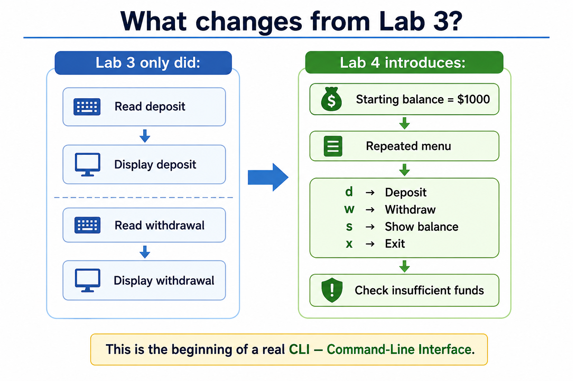
Lab 4 — DeskBankApp Second Implementation
Understand → Start with a small template → Add one requirement at a time → Test → Complete solution.

Slide 61
Lab 4 — DeskBankApp Second Implementation
Case Study — DeskBankApp Second Implementation
Requirement
The Bank system must:
start with $1000.00
repeatedly ask for d, w, s, or x
deposit money
withdraw money
prevent withdrawals greater than the balance
show the current balance
stop only when x is entered

Slide 62
Lab 4 — DeskBankApp Second Implementation
Step 1 — Create the Bank structure
Python
class Bank:
pass
This creates the Bank class.
Java
public class Bank {
}
This creates the Java Bank class.

Slide 63
Lab 4 — DeskBankApp Second Implementation
Step 2 — Add the starting balance
Python
class Bank:
def __init__(self):
self.balance = 1000.0
self.balance stores the current account balance.
Java
public class Bank {
private double balance = 1000.0;
}
private means the balance belongs to the Bank object and should not be directly changed from outside.

Slide 64
Lab 4 — DeskBankApp Second Implementation
Step 3 — Add deposit behaviour
Python
def deposit(self, amount):
self.balance += amount
If the balance is $1000 and we deposit $500:
1000 + 500 = 1500
Java
public void deposit(double amount) {
balance += amount;
}
void means the method performs an action and does not return a value.

Slide 65
Lab 4 — DeskBankApp Second Implementation
Step 4 — Add withdrawal behaviour
We must prevent customers from withdrawing more money than they have.
Python
def withdraw(self, amount):
if amount > self.balance:
raise ValueError("Insufficient funds")
self.balance -= amount
If:
Balance = $1000
Withdraw = $5000
the program raises an exception.
Java
public void withdraw(double amount) {
if (amount > balance) {
throw new IllegalArgumentException("Insufficient funds");
}
balance -= amount;
}
The exception can then be handled using try and catch.

Slide 66
Lab 4 — DeskBankApp Second Implementation
Step 5 — Add show balance
Python
def show_balance(self):
print(f"Starting balance: ${self.balance:.2f}")
Java
public void showBalance() {
System.out.printf("Starting balance: $%.2f%n", balance);
}

Slide 67
Lab 4 — DeskBankApp Second Implementation
Step 6 — Build the repeated menu
We need a loop.
Python
while True:
choice = input("Continue banking (d/w/s/x): ").lower()
while True means:
Keep repeating until we explicitly stop the loop.

Slide 68
Lab 4 — DeskBankApp Second Implementation
Java
while (true) {
System.out.print("Continue banking (d/w/s/x): ");
}
Again, this repeats until break is executed.

Slide 69
Lab 4 — DeskBankApp Second Implementation
Step 7 — Process each menu choice
Python
if choice == "d":
# deposit
elif choice == "w":
# withdraw
elif choice == "s":
# show balance
elif choice == "x":
break
Java
switch (choice) {
case "d":
break;
case "w":
break;
case "s":
break;
case "x":
break;
}

Slide 70
Step 8 — Completed Python Bank solution
class Bank:
def __init__(self):
self.balance = 1000.0
def deposit(self, amount):
self.balance += amount
def withdraw(self, amount):
if amount > self.balance:
raise ValueError("Insufficient funds")
self.balance -= amount
def show_balance(self):
print(f"Starting balance: ${self.balance:.2f}")
def main():
bank = Bank()
choice = input("Start banking (d/w/s/x): ").lower()
while choice != "x":
if choice == "d":
amount = float(input("Amount to deposit: $"))
bank.deposit(amount)
print(f"Amount deposited: ${amount:.2f}")
elif choice == "w":
amount = float(input("Amount to withdraw: $"))
try:
bank.withdraw(amount)
print(f"Amount withdrawn: ${amount:.2f}")
except ValueError as error:
print(error)
elif choice == "s":
bank.show_balance()
else:
print("Invalid choice")
choice = input(
"Continue banking (d/w/s/x): "
).lower()
if __name__ == "__main__":
main()
Important parts
self.balance = 1000.0
sets the initial balance.
while choice != "x":
keeps the banking system running.
raise ValueError("Insufficient funds")
creates an exception if the customer tries to withdraw too much.
try:
attempts the withdrawal.
except ValueError:
handles the problem without crashing the program.

Slide 71
Step 9 — Completed Java Bank solution
import java.util.Scanner;
"Amount deposited: $%.2f%n",
depositAmount
);
break;
case "w":
System.out.print(
"Amount to withdraw: $"
);
double withdrawAmount =
input.nextDouble();
input.nextLine();
try {
bank.withdraw(withdrawAmount);
System.out.printf(
"Amount withdrawn: $%.2f%n",
withdrawAmount
);
} catch (
IllegalArgumentException error
) {
System.out.println(
error.getMessage()
);
}
break;
case "s":
bank.showBalance();
break;
default:
System.out.println(
"Invalid choice"
);
}
System.out.print(
"Continue banking (d/w/s/x): "
);
choice =
input.nextLine().toLowerCase();
}
input.close();
}
}

Slide 72
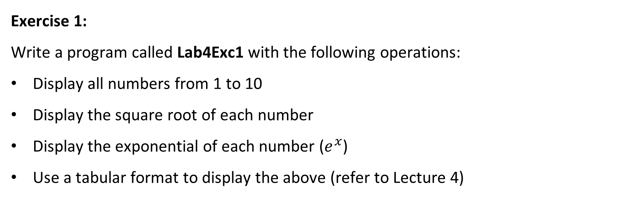
Lab 4 Exercises
Exercise 1:
Write a program called Lab4Exc1 with the following operations:
Display all numbers from 1 to 10
Display the square root of each number
Display the exponential of each number ($e^{x}$)
Use a tabular format to display the above (refer to Lecture 4)

Slide 73
Exercise 1 — Numbers, Square Roots and Exponentials
We need to display:
Number Square Root e^x
1
2
...
10
Step 1 — Understand the mathematics
For every number x from 1 to 10:
Square root = √x
Exponential = e^x

Slide 74
Exercise 1 — Numbers, Square Roots and Exponentials
Step 2 — Python loop
for x in range(1, 11):
print(x)
range(1, 11) produces:
1 2 3 4 5 6 7 8 9 10

Slide 75
Exercise 1 — Numbers, Square Roots and Exponentials
Step 3 — Python calculations
square_root = math.sqrt(x)
exponential = math.exp(x)

Slide 76
Exercise 1 — Numbers, Square Roots and Exponentials
Completed Python — Lab4Exc1.py
import math
print(
f"{'Number':<10}"
f"{'Square Root':<15}"
f"{'e^x':<15}"
)
for x in range(1, 11):
square_root = math.sqrt(x)
exponential = math.exp(x)
print(
f"{x:<10}"
f"{square_root:<15.2f}"
f"{exponential:<15.2f}"
)

Slide 77
Exercise 1 — Numbers, Square Roots and Exponentials
Java — Step 1
Use a for loop:
for (int x = 1; x <= 10; x++) {
}

Slide 78
Exercise 1 — Numbers, Square Roots and Exponentials
Java — Step 2
double squareRoot = Math.sqrt(x);
double exponential = Math.exp(x);

Slide 79
Exercise 1 — Numbers, Square Roots and Exponentials
Completed Java — Lab4Exc1.java
public class Lab4Exc1 {
public static void main(String[] args) {
System.out.printf(
"%-10s %-15s %-15s%n",
"Number",
"Square Root",
"e^x"
);
for (int x = 1; x <= 10; x++) {
double squareRoot =
Math.sqrt(x);
double exponential =
Math.exp(x);
System.out.printf(
"%-10d %-15.2f %-15.2f%n",
x,
squareRoot,
exponential
);
}
}
}

Slide 80
Lab 4 Exercises
Exercise 2 (Java):
Write a program called Lab4Exc2 with the following operations:
Generate 20 random integers
Store the values into an array
Display the array

Slide 81
Exercise 2 — Generate 20 Random Integers
The supplied exercise says Java, but below is also the Python equivalent for comparison.
The random-number range is not specified. The examples below use 0–99.
Python — Step 1
Create an empty list:
numbers = []

Slide 82
Exercise 2 — Generate 20 Random Integers
Step 2
Generate twenty random numbers:
for i in range(20):
number = random.randint(0, 99)
numbers.append(number)

Slide 83
Exercise 2 — Generate 20 Random Integers
Completed Python
import random
numbers = []
for i in range(20):
number = random.randint(0, 99)
numbers.append(number)
print(numbers)

Slide 84
Exercise 2 — Generate 20 Random Integers
Java — Step 1
Create an array:
int[] numbers = new int[20];

Slide 85
Exercise 2 — Generate 20 Random Integers
Step 2
Create a random-number generator:
Random random = new Random();

Slide 86
Exercise 2 — Generate 20 Random Integers
Step 3
Fill the array:
for (int i = 0; i < numbers.length; i++) {
numbers[i] = random.nextInt(100);
}

Slide 87
Exercise 2 — Generate 20 Random Integers
Completed Java — Lab4Exc2.java
import java.util.Arrays;
import java.util.Random;
public class Lab4Exc2 {
public static void main(String[] args) {
int[] numbers = new int[20];
Random random = new Random();
for (
int i = 0;
i < numbers.length;
i++
) {
numbers[i] =
random.nextInt(100);
}
System.out.println(
Arrays.toString(numbers)
);
}
}

Slide 88
Lab 4 Exercises
Exercise 3:
Write a program called Lab4Exc3 with the following operations:
Repeatedly print out n stars in one line, where the value of n is captured from the keyboard.
NOTES:
Don't forget to terminate the previous line.
The program should terminate when n is zero.

Slide 89
Exercise 3 — Print n Stars Until 0
If the user enters:
5
print:
*****
If the user enters:
3
print:
***
Entering 0 stops the program.

Slide 90
Exercise 3 — Print n Stars Until 0
Python — Step 1
n = int(input("Enter n: "))
Step 2
Repeat until zero:
while n != 0:
Step 3
Python can repeat a string:
print("*" * n)

Slide 91
Exercise 3 — Print n Stars Until 0
Completed Python — Lab4Exc3.py
n = int(input("Enter n: "))
while n != 0:
print("*" * n)
n = int(input("Enter n: "))

Slide 92
Exercise 3 — Print n Stars Until 0
Java — Step 1
Read n:
int n = input.nextInt();
Step 2
Nested loop:
while (n != 0) {
for (int i = 0; i < n; i++) {
System.out.print("*");
}
System.out.println();
}

Slide 93
Exercise 3 — Print n Stars Until 0
Completed Java — Lab4Exc3.java
import java.util.Scanner;
public class Lab4Exc3 {
public static void main(String[] args) {
Scanner input = new Scanner(System.in);
System.out.print("Enter n: ");
int n = input.nextInt();
while (n != 0) {
for (int i = 0; i < n; i++) {
System.out.print("*");
}
System.out.println();
System.out.print("Enter n: ");
n = input.nextInt();
}
input.close();
}
}

Slide 94
Lab 4 Exercises
Exercise 4:
Write a program called Lab4Exc4 with the following operations :
Repeatedly read an integer n from the keyboard.
Display the min and max values entered.
NOTE:
The program stops taking inputs from keyboard when -1 is entered.

Slide 95
Exercise 4 — Find Minimum and Maximum
The user repeatedly enters numbers.
-1 means stop.
Important idea
We should not automatically set:
min = 0
max = 0
because all entered numbers could be positive or negative.
A simple solution is to use the first valid number to initialize both.

Slide 96
Exercise 4 — Find Minimum and Maximum
Python — Step 1
minimum = None
maximum = None
None means:
We do not have a value yet.

Slide 97
Exercise 4 — Find Minimum and Maximum
Step 2
Read repeatedly:
while True:

Slide 98
Exercise 4 — Find Minimum and Maximum
Completed Python — Lab4Exc4.py
minimum = None
maximum = None
while True:
n = int(input("Enter an integer (-1 to stop): "))
if n == -1:
break
if minimum is None:
minimum = n
maximum = n
else:
if n < minimum:
minimum = n
if n > maximum:
maximum = n
if minimum is not None:
print("Minimum:", minimum)
print("Maximum:", maximum)
else:
print("No values entered.")

Slide 99
Java — Step 1
Use a Boolean variable:
boolean firstValue = true;
Completed Java — Lab4Exc4.java
import java.util.Scanner;
boolean firstValue = true;
while (true) {
System.out.print(
"Enter an integer (-1 to stop): "
);
int n = input.nextInt();
if (n == -1) {
break;
}
if (firstValue) {
minimum = n;
maximum = n;
firstValue = false;
} else {
if (n < minimum) {
minimum = n;
}
if (n > maximum) {
maximum = n;
}
}
}
if (!firstValue) {
System.out.println(
"Minimum: " + minimum
);
System.out.println(
"Maximum: " + maximum
);
} else {
System.out.println(
"No values entered."
);
}
input.close();
}
}

Slide 100
Lab 4 Exercises
Exercise 5:
Write a program called Lab4Exc5 with the following operations:
Add all even numbers from 1 up to n and print the sum, where the value of n is entered from keyboard.
The program should print the even-sum of every entered n.
NOTE:
The program stops taking inputs from keyboard when -1 is entered.

Slide 101
Exercise 5 — Sum Even Numbers from 1 to n
For example:
n = 10
Even numbers are:
2 + 4 + 6 + 8 + 10
Result:
30
The program repeats until -1.

Slide 102
Exercise 5 — Sum Even Numbers from 1 to n
Python — Step 1
total = 0
Step 2
Visit only even values:
for number in range(2, n + 1, 2):
The final 2 means:
Increase by 2 each time.

Slide 103
Exercise 5 — Sum Even Numbers from 1 to n
Completed Python — Lab4Exc5.py
while True:
n = int(input("Enter n (-1 to stop): "))
if n == -1:
break
even_sum = 0
for number in range(2, n + 1, 2):
even_sum += number
print(f"Even sum up to {n}: {even_sum}")

Slide 104
Exercise 5 — Sum Even Numbers from 1 to n
Java — Completed Solution
import java.util.Scanner;
public class Lab4Exc5 {
public static void main(String[] args) {
Scanner input = new Scanner(System.in);
while (true) {
System.out.print(
"Enter n (-1 to stop): "
);
int n = input.nextInt();
if (n == -1) {
break;
}
int evenSum = 0;
for (
int number = 2;
number <= n;
number += 2
) {
evenSum += number;
}
System.out.println(
"Even sum up to "
+ n
+ ": "
+ evenSum
);
}
input.close();
}
}

Slide 105
Lab 4 Exercises
Exercise 6:
Write a program called Lab4Exc6 with the following operations:
Generate a random number of seed 10, n times (n is entered from keyboard).
Calculate and show the even-sum of the random numbers.

Slide 106
Exercise 6 — Seeded Random Numbers and Even Sum
Important clarification
The task says:
Generate a random number of seed 10, n times.
This normally means:
Create a random-number generator using seed 10, then generate n random numbers.
A seed makes the random sequence repeatable.
The range was not supplied, so below I use:
0–99

Slide 107
Exercise 6 — Seeded Random Numbers and Even Sum
Python — Step 1
random.seed(10)
This initializes the generator with seed 10.
Step 2
number = random.randint(0, 99)
Step 3
Check whether it is even:
if number % 2 == 0:
even_sum += number

Slide 108
Exercise 6 — Seeded Random Numbers and Even Sum
Completed Python — Lab4Exc6.py
import random
n = int(input("How many random numbers? "))
random.seed(10)
even_sum = 0
for i in range(n):
number = random.randint(0, 99)
print(number)
if number % 2 == 0:
even_sum += number
print("Even sum:", even_sum)

Slide 109
Completed Java — Lab4Exc6.java
import java.util.Random;
import java.util.Scanner;
public class Lab4Exc6 {
public static void main(String[] args) {
Scanner input = new Scanner(System.in);
System.out.print(
"How many random numbers? "
);
int n = input.nextInt();
Random random =
new Random(10);
int evenSum = 0;
for (int i = 0; i < n; i++) {
int number =
random.nextInt(100);
System.out.println(number);
if (number % 2 == 0) {
evenSum += number;
}
}
System.out.println(
"Even sum: " + evenSum
);
input.close();
}
}
Java
Create the seeded generator
Random random = new Random(10);

Slide 110
Lab 4 Exercises
Exercise 7:
Write a program called Lab4Exc7 with the following operations:
Read characters from keyboard until dot (.) is entered
Count the number of vowels entered
Both uppercase and lowercase vowels should be counted
Display the total vowel count
NOTE:
The program stops when . is entered from keyboard

Slide 111
Exercise 7 — Count Vowels Until Dot
Vowels are:
a e i o u
A E I O U
. terminates the program and should not be counted.

Slide 112
Exercise 7 — Count Vowels Until Dot
Python — Step 1
Create a counter:
vowel_count = 0
Step 2
Read a character:
character = input("Enter a character: ")
Step 3
Check vowels:
if character.lower() in "aeiou":

Slide 113
Exercise 7 — Count Vowels Until Dot
Completed Python — Lab4Exc7.py
vowel_count = 0
while True:
character = input("Enter a character (. to stop): ")
if character == ".":
break
if ( len(character) > 0 and character[0].lower() in "aeiou"):
vowel_count += 1
print("Total vowel count:", vowel_count))

Slide 114
Exercise 7 — Count Vowels Until Dot
Java
Convert the character to lowercase:
char ch =
Character.toLowerCase(
input.next().charAt(0)
);

Slide 115
Completed Java — Lab4Exc7.java
import java.util.Scanner;
public class Lab4Exc7 {
public static void main(String[] args) {
Scanner input = new Scanner(System.in);
int vowelCount = 0;
while (true) {
System.out.print(
"Enter a character (. to stop): "
);
char ch =
input.next().charAt(0);
if (ch == '.') {
break;
}
ch =
Character.toLowerCase(ch);
if (
ch == 'a'
|| ch == 'e'
|| ch == 'i'
|| ch == 'o'
|| ch == 'u'
) {
vowelCount++;
}
}
System.out.println(
"Total vowel count: "
+ vowelCount
);
input.close();
}
}

Slide 116
Lab 4 Exercises
Exercise 8:
Write a program called Lab4Exc8 with the following operations:
Calculate the factorial of n (where n is entered from keyboard)
Show the factorial of n

Slide 117
Exercise 8 — Factorial
Factorial is:
5! = 5 × 4 × 3 × 2 × 1
= 120
Also:
0! = 1

Slide 118
Exercise 8 — Factorial
Python — Step 1
factorial = 1
Step 2
for number in range(1, n + 1):
factorial *= number

Slide 119
Completed Python — Lab4Exc8.py
n = int(input("Enter n: "))
if n < 0:
print(
"Factorial is not defined "
"for negative numbers."
)
else:
factorial = 1
for number in range(1, n + 1):
factorial *= number
print( f"{n}! = {factorial}")

Slide 120
Java — Completed Solution
Using long allows somewhat larger results than int.
import java.util.Scanner;
public class Lab4Exc8 {
public static void main(String[] args) {
Scanner input = new Scanner(System.in);
System.out.print("Enter n: ");
int n = input.nextInt();
if (n < 0) {
System.out.println(
"Factorial is not defined "
+ "for negative numbers."
);
} else {
long factorial = 1;
for (
int number = 1;
number <= n;
number++
) {
factorial *= number;
}
System.out.println(
n + "! = " + factorial
);
}
input.close();
}
}

Slide 121
Lab 4 Exercises
Exercise 9:
Write a program called Lab4Exc9 with the following operations:
Generates a random integer between 1 and 10 (inclusive). [Never print this number]
Keep guessing the correct random integer.
If your guess is correct, print “Success, secret number = <the number value>” and terminate the program
If your guess is incorrect print “Sorry – try again!”, then keep trying.

Slide 122
Exercise 9 — Guess the Secret Number

Slide 123
Exercise 9 — Guess the Secret Number
Python — Step 1
secret_number = random.randint(1, 10)
Do not print this value.
Step 2
Repeat guesses:
while True:

Slide 124
Exercise 9 — Guess the Secret Number
Completed Python — Lab4Exc9.py
import random
secret_number =
random.randint(1, 10)
while True:
guess = int(
input(
"Guess the secret number (1-10): "
)
)
if guess == secret_number:
print(
"Success, secret number =",
secret_number
)
break
else:
print(
"Sorry - try again!"
)
The first assignment should be written on one line in an actual Python file:
secret_number = random.randint(1, 10)

Slide 125
Exercise 9 — Guess the Secret Number
Complete Python Code:
import random
secret_number = random.randint(1, 10)
while True:
guess = int(
input("Guess the secret number (1-10): ")
)
if guess == secret_number:
print(
f"Success, secret number = {secret_number}"
)
break
else:
print("Sorry - try again!")

Slide 126
Exercise 9 — Guess the Secret Number
So the complete code is:
import random
secret_number = random.randint(1, 10)
while True:
guess = int(
input("Guess the secret number (1-10): ")
)
if guess == secret_number:
print(
f"Success, secret number = {secret_number}"
)
break
else:
print("Sorry - try again!")
Why + 1?
random.nextInt(10)
produces:
0–9
Therefore:
random.nextInt(10) + 1
produces:
1–10

Slide 127
Lab 4 Exercises
Exercise 10:
Write a program called Lab4Exc10 with the following operations:
Calculate and print the values of a Fibonacci series on separate lines.
NOTE:
First number is 1
Second number is 1
Last Fibonacci number n [n is entered from keyboard]
Notes:
Calculate and print each subsequent number in the series until the next number would be greater than n.

Slide 128
Exercise 10 — Fibonacci Series
The first two values are:
1
1
After that:
next = previous + current
So:
1
1
2
3
5
8
13
21
...
I interpret n as the number of Fibonacci values to display.

Slide 129
Exercise 10 — Fibonacci Series
Python — Step 1
first = 1
second = 1
Step 2
Handle small values
If:
n = 1
only print:
1
If:
n >= 2
print both starting values.
Step 3 — Calculate the next value
next_number = first + second
Then shift:
first = second
second = next_number

Slide 130
Completed Python — Lab4Exc10.py
n = int(
input(
"How many Fibonacci numbers? "
)
)
if n <= 0:
print(
"Please enter a positive number."
)
else:
first = 1
second = 1
if n >= 1:
print(first)
if n >= 2:
print(second)
for i in range(3, n + 1):
next_number =
first + second
print(next_number)
first = second
second = next_number
The assignment line must appear on one line in Python:
next_number = first + second
So the copy-ready version is:
n = int(input("How many Fibonacci numbers? "))
if n <= 0:
print("Please enter a positive number.")
else:
first = 1
second = 1
if n >= 1:
print(first)
if n >= 2:
print(second)
for i in range(3, n + 1):
next_number = first + second
print(next_number)
first = second
second = next_number

Slide 131
Java — Step 1
long first = 1;
long second = 1;

Slide 132
Completed Java — Lab4Exc10.java
import java.util.Scanner;
public class Lab4Exc10 {
public static void main(String[] args) {
Scanner input = new Scanner(System.in);
System.out.print(
"How many Fibonacci numbers? "
);
int n = input.nextInt();
if (n <= 0) {
System.out.println(
"Please enter a positive number."
);
} else {
long first = 1;
long second = 1;
if (n >= 1) {
System.out.println(first);
}
if (n >= 2) {
System.out.println(second);
}
for (
int i = 3;
i <= n;
i++
) {
long nextNumber =
first + second;
System.out.println(
nextNumber
);
first = second;
second = nextNumber;
}
}
input.close();
}
}

Slide 133

Let’s Answer Your Questions
Canvas Inbox – For academic queries.
Email – For formal communication and attachments.
Canvas Discussion – For academic discussions and general queries.
Reminder – Please follow up if you do not receive a response within 3 business days.

Slide 134

Happy Learning and Bright Futures Ahead! Dr. Farshid Keivanian Stay Connected: linkedin.com/in/farshid-keivanian github.com/FarshidKeivanian
Education is the most powerful weapon you can use to change the world. — Nelson Mandela

